Slide 3
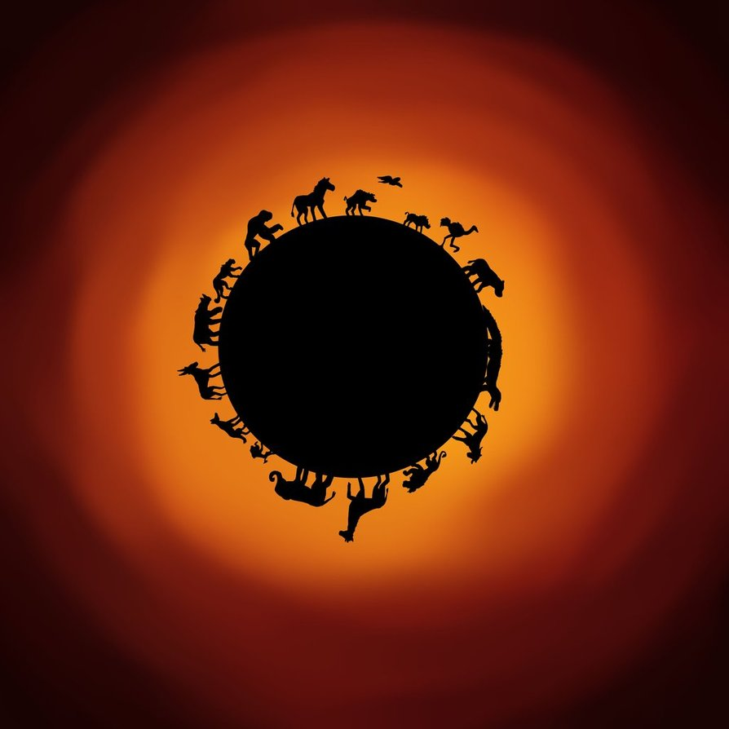

Slide 4
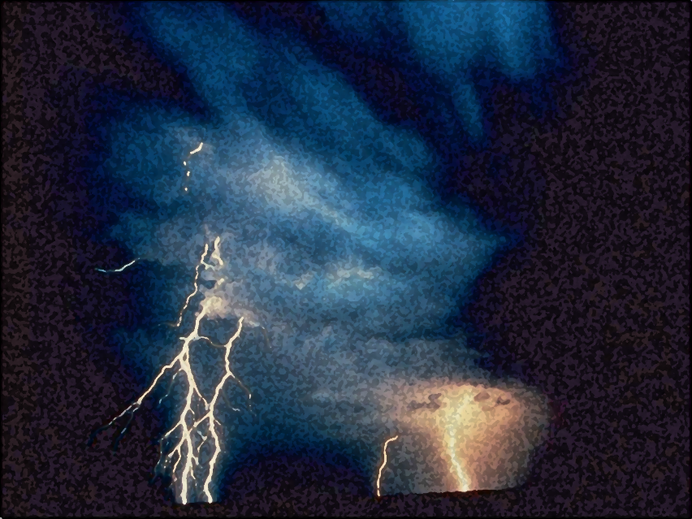
Light out of Darkness
The Vision of Isaiah
Doom to Bloom

Slide 5
The Vision of Isaiah
How to become a useful, faithful and righteous servant of God.
A Call to Servanthood
How does sinful Israel become servant Israel?

Slide 6
The Vision of Isaiah
The Problem:
What Israel Is
Versus
What Israel Will Be 2:1 – 4:6

Slide 7
The Vision of Isaiah
The Problem:
Sinful Israel
Versus
Servant Israel
2:1 – 4:6

Slide 8
The Vision of Isaiah
The Solution:
Trusting the Lord
Versus
Trusting the Nations
Chs. 7 - 39

Slide 9
The Vision of Isaiah
Destiny of the House of Jacob
2:1-5
House of Jacob Forsaken
2:6 – 4:1
Israel Restored
4:2-6
“will be”
“is”
“will be”
Notes:
Israel can only fulfill the destiny given to her in 2:1-5 by experiencing the judgment expressed throughout 2:6 – 4:1 and the purification described in 4:2-6. “proud self-sufficient Israel can become the witness to the greatness of God only when she has been reduced to helplessness by his just judgment and then restored to life by his unmerited grace.” (Oswalt, p. 113)

Slide 10
The Vision of Isaiah
The House of Jacob Forsaken
2:6 - 4:1
“what is”
A Tone of Hopelessness

Slide 11
The Vision of Isaiah
Trusting in Mankind
2:6 - 22
The Folly of Mankind Exalting Himself

Slide 12
The Vision of Isaiah
Instead of teaching the nations God’s ways, Israel was being taught the ways of the world. They were learning dependence on human greatness, but Isaiah shows in 2:6 – 4:1 by a series of stunning contrast how such dependence does not exalt, but humiliates.
Notes:
True greatness cannot appear until God’s greatness is permitted to shine over all. Until this takes place, humanity’s potential is zero.

Slide 13
The Vision of Isaiah
2:6-17 – The Cause of the Problem:
Human Pride and Self-
Sufficiency
2:18-22 – The Devastating Effect:
Humiliation

Slide 14
“forsaken”
“For You have forsaken Your people, the house of Jacob...” (2:6a)
“A Shock Prophet”
Notes:
This is shocking statement from the “Shock Prophet” with another abrupt shift in mood.
Why has God forsaken His people? - Israel was not walking in that light but have forsaken God, therefore God has forsaken Israel.

Slide 15
“forsaken”
The LORD would overthrew the whole land in His anger and His wrath. “All nations would say, 'Why has the LORD done so to this land? What does the heat of this great anger mean?” (Deut. 29:23-25)

Slide 16
“forsaken”
“Then people would say: 'Because they have forsaken the covenant of the LORD God of their fathers, which He made with them when He brought them out of the land of Egypt; for they went and served other gods and worshiped them, gods that they did not know and that He had not given to them…”

Slide 17
“forsaken”
“Then the anger of the LORD was aroused against this land, to bring on it every curse that is written in this book. And the LORD uprooted them from their land in anger, in wrath, and in great indignation, and cast them into another land, as it is this day.” (Deut. 29:25-28)

Slide 18
“forsaken”
“And it will be when you say, 'Why does the LORD our God do all these things to us?' Then you shall answer them, 'Just as you have forsaken Me and served foreign gods in your land, so you shall serve aliens in a land that is not yours.” (Jer. 5:19)

Slide 19
“forsaken”
“Then the children of Israel again did evil in the sight of the LORD, and served the Baals and… (others gods) they forsook the LORD and did not serve Him. So the anger of the LORD was hot against Israel; and He sold them into the hands of the Philistines… and oppressed the children of Israel for eighteen years.” (Judg. 10:6-8)

Slide 20
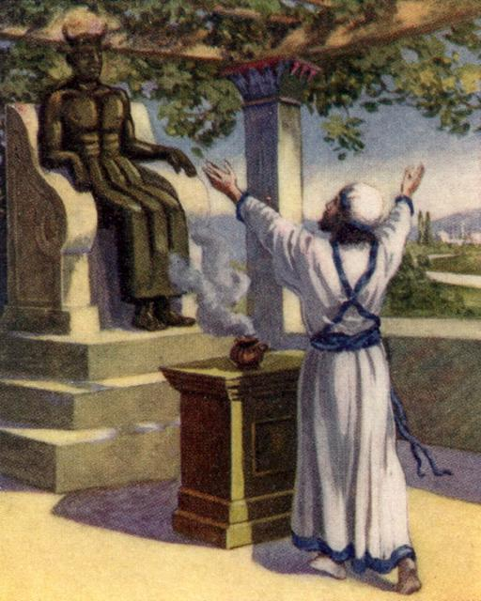
“forsaken”
“And the children of Israel cried out to the LORD, saying, "We have sinned against You, because we have both forsaken our God and served the Baals! (Judg. 10:10)

Slide 21
“forsaken”
God responded “Yet you have forsaken Me and served other gods. Therefore I will deliver you no more. Go and cry out to the gods which you have chosen; let them deliver you in your time of distress.” (10:13)

Slide 22
“forsaken”
“And the children of Israel said to the LORD, "We have sinned!... So they put away the foreign gods from among them and served the LORD. And His soul could no longer endure the misery of Israel.” (10:15-16)

Slide 23
“forsaken”
“they have rejected Me, that I should not reign over them. According to all the works which they have done since the day that I brought them up out of Egypt, even to this day -- with which they have forsaken Me and served other gods.” (1 Sam. 8:7-8)

Slide 24
“forsaken”
The prophet Ahijah “said to Jeroboam,… ‘Behold, I will tear the kingdom out of the hand of Solomon and will give ten tribes to you…” because they have forsaken Me, and worshiped Ashtoreth the goddess of the Sidonians… (etc.)”

Slide 25
“forsaken”
“… and have not walked in My ways to do what is right in My eyes and keep My statutes and My judgments, as did his father David.” (1 Kings 11:31, 33-34)
Zion was “the faithful city” during the reign of David and Solomon

Slide 26
“forsaken”
“And Elijah answered Ahab, ‘I have not troubled Israel, but you and your father's house have, in that you have forsaken the commandments of the LORD and have followed the Baals.” (1 Kings 18:18)

Slide 27
“forsaken”
“Thus says God: 'Why do you [Joash] transgress the commandments of the LORD, so that you cannot prosper? Because you have forsaken the LORD, He also has forsaken you.'
(2 Chron. 24:20)

Slide 28
“forsaken”
“Ahaz walked in the ways of the kings of Israel, and made molded images for the Baals… He burned incense and burned his children in the fire… he sacrificed and burned incense on the high places, on the hills, and under every green tree.” (2 Chron. 28:2-4)

Slide 29
“forsaken”
“Therefore the LORD his God delivered Ahaz into the hand of the king of Syria. They defeated him, and carried away a great multitude of them as captives,… because they had forsaken the LORD God of their fathers.” (2 Chron. 28:5-6)

Slide 30
“forsaken”
“You have forsaken Me," says the LORD, ‘You have gone backward. Therefore I will stretch out My hand against you and destroy you; I am weary of relenting!” (Jer. 15:6)
If they will not relent then neither will God.
Notes:
If they will not change their ways then restoration will only come to through the humiliation and the destruction.

Slide 31
“forsaken”
“Yet the fortified city will be desolate, the habitation forsaken and left like a wilderness;…” (Isa 27:10)

Slide 32
“forsaken”
“Thus the LORD said to Josiah: 'Behold, I will bring calamity on this place and on its inhabitants… because they have forsaken Me and burned incense to other gods, that they might provoke Me to anger with all the works of their hands…” (1 Kings 22:16-17)

Slide 33
“forsaken”
“…because your heart was tender, and you humbled yourself before the LORD when you heard what I spoke against this place and against its inhabitants, that they would become a desolation and a curse, and you tore your clothes and wept before Me, I also have heard you,…"

Slide 34
“forsaken”
“Surely, therefore, I will gather you to your fathers, and you shall be gathered to your grave in peace; and your eyes shall not see all the calamity which I will bring on this place.” (1 Kings 22:19-20)
The Forsaking was Postponed

Slide 35
“forsaken”
The Righteous are Not Forsaken
“The LORD also will be a refuge for the oppressed, a refuge in times of trouble. And those who know Your name will put their trust in You; For You, LORD, have not forsaken those who seek You.”(Psalm 9:9-10)

Slide 36
“forsaken”
Forsaken, But Not Forgotten
“But Zion said, ‘The LORD has forsaken me, and my Lord has forgotten me.’ ‘Can a woman forget her nursing child, and not have compassion on the son of her womb? Surely they may forget, Yet I will not forget you.” (Isa. 49:14-15)

Slide 37
“forsaken”
The Forsaking is Not Forever
“For a mere moment I have forsaken you, but with great mercies I will gather you. With a little wrath I hid My face from you for a moment; But with everlasting kindness I will have mercy on you,“ Says the LORD, your Redeemer.” (Isa. 54:7-8)

Slide 38
“forsaken”
“You shall no longer be termed Forsaken”… A City Not Forsaken. (Isa. 62:4a, 12b)
“For Israel is not forsaken, nor Judah,… though their land was filled with sin against the Holy One of Israel.” (Jer. 51:5)

Slide 39
“forsaken”
“For You have forsaken Your people, the house of Jacob...” (2:6a)
Israel [mankind] is forsaken by God because they have forsaken God in their feeble attempt to elevate themselves above Him.
Notes:
Israel was not walking in that light but have forsaken God, therefore God has forsaken Israel.

Slide 40
“forsaken”
Trusting in Mankind
2:6 - 22
Mankind is
Full, but Empty
2:6-11

Slide 41
“forsaken”
“Because they are filled with eastern ways; They are soothsayers like the Philistines, and they are pleased with the children of foreigners.” (2:6b)
Full of Pagan ways from East to West
Notes:
East – Assyria and Babylon. West – Philistines. They have borrowed the pagan ways for east to west. “…pleased with the children of foreigners” refers to making alliances with the nations with the idea of recognition of the foreign gods. We can have our God, Jehovah and the gods of the nations as well, this makes us even more powerful.
The use of divinations and magic was forbidden in the Law. The pagans sought to gain control of their own destinies, their national and personal security by manipulating the gods. God called Israel to trust in Him for their security and to give attention to justice and righteousness. At this point they are not listening to God but to the nations.

Slide 42
“forsaken”
“Their land is also full of silver and gold, and there is no end to their treasures; Their land is also full of horses, and there is no end to their chariots. Their land is also full of idols; (2:7-8a)
Full of wealth, armaments and idols
Notes:
The accumulation of military power and wealth was also forbidden to the king on the grounds that it would turn the king away form God. The desire for this world’s security lead to assimilation of the world’s gods. Israel had amassed great wealth and power during the long reign of Uzziah, since the time of Solomon. Wealth and power are to be understood to be God’s gift alone and not the work of human hands through idols.
Idolatry is ultimately the creation of God in man’s image for the purpose of achieving human ends. It is thus the utmost exaltation of mankind.

Slide 43
“forsaken”
“They worship the work of their own hands, that which their own fingers have made.” People bow down, and each man humbles himself; (2:8b-9a)
Idolatry is foolishness. How foolish to call divine what humans hands have made.
Notes:
These idols/gods are not gods at all. They are no-gods.

Slide 44
“forsaken”
“Perhaps the best definition of an idol is something we ourselves make into a god. It does not have to be a statue or a tree. It can be anything that stands between us and God or something we substitute for God.”
(Nelson's Illustrated Bible Dictionary, Copyright (c)1986, Thomas Nelson Publishers)

Slide 45
“forsaken”
“Self idolatry, self will, and self sufficiency must be subdued, if God is to be our God… ‘conscious disobedience is idolatry, because it makes self will, the human I, into a god" (Keil).
(Fausset's Bible Dictionary, Electronic Database Copyright (c)1998 by Biblesoft)

Slide 46
“forsaken”
The worlds best wisdom says it is through the accumulation of wealth, power, and control that humans beings become great.
This is not to be so! They will be humbled and brought low when the true source of greatness appears.

Slide 47
“forsaken”
“Enter into the rock, and hide in the dust, from the terror of the LORD and the glory of His majesty. The lofty looks of man shall be humbled, the haughtiness of men shall be bowed down, and the LORD alone shall be exalted in that day.” (2:10)
Notes:
Man’s greatness could be compared to a flashlight at night, but no match for the sun. When the Son appears there will be no more cause to glory in human greatness. Man’s quest for total self-sufficiency has reduced him to nothing. It will truly be a terror when the Holy One appears for those who have lived lives for themselves.

Slide 48
“forsaken”
“Therefore do not forgive them.” (2:9b)
The Problem with Sin
How does God forgive sin and not violate His justice?
Notes:
An abrupt statement. Why? Is Isaiah almost afraid that God might relent and in violation of His own justice, forget their heinous sins? This phrase expose the problem of sin for God. It must not be simply forgotten, sin must be punished. The solution is never really answered in Chapters 1-39. Only in the second part of the book does the answer come. “But whatever the answer, it is not to be found in acting as if the sin had not been committed.” (Oswalt, p. 125)

Slide 49
“forsaken”
Trusting in Mankind
2:6 - 22
Mankind is
High, but Low
2:12-17

Slide 50
“forsaken”
“For the day of the LORD of hosts
shall come upon everything proud and lofty, upon everything lifted up -- And it shall be brought low” (2:12)
Notes:
The section expands the theme in a poetic way. God alone is high and lifted up. Nothing else is high expect by permission from God. The contrast is very striking with vs. 1-4. Israel has learned from the nations by the means of wealth, power and control to exalt themselves. But everything that attempts to exalt themselves, to proclaim their own greatness, will but brought low.
When we exalt God, we too, are lifted up. When we exalt ourselves we inevitably humiliate ourselves, leaving God alone exalted.

Slide 51
“forsaken”
“For the day of the LORD of hosts
shall come upon everything proud and lofty, upon everything lifted up -- And it shall be brought low” (2:12)
Notes:
The “day of the Lord” is a prominent theme throughout the prophets. It is a time when God will vindicate his people and bless their endeavors. But it is also a time of destruction and terror, and only after that could blessing come.

Slide 52
“forsaken”
“Upon all the cedars of Lebanon that are high and lifted up, and upon all the oaks of Bashan; Upon all the high mountains, and upon all the hills that are lifted up;” (2:13-14)

Slide 53
“forsaken”
“Upon every high tower, and upon every fortified wall; Upon all the ships of Tarshish, and upon all the beautiful sloops.” (2:15-16)

Slide 54
“forsaken”
“The loftiness of man shall be bowed down, and the haughtiness of men shall be brought low; The LORD alone will be exalted in that day,” (2:17)
Notes:
Everything that mankind uses to build his greatness will be brought down. What God opposes is not nature itself (trees, and hills and things) but human arrogance and pride. As surely as wind uproots trees, and knocks down high tower, and sinks ships, and as surely earthquakes moves mountains, hills and cracks fortified walls, so will the terror of the Lord remove all splendor and self-importance of man when He appears.

Slide 55
“forsaken”
Trusting in Mankind
2:6 - 22
Mankind is
Reduced to Caves
2:18-22

Slide 56
“forsaken”
“But the idols He shall utterly abolish. They shall go into the holes of the rocks, and into the caves of the earth, from the terror of the LORD and the glory of His majesty, when He arises to shake the earth mightily.” (2:18-19)
Notes:
The ultimate humiliation is depicted here. Humans become troglodytes, cave dwellers. Their pursuit of greatness apart from God has robbed them of their dignity which could have been righty theirs.

Slide 57
“forsaken”
“And the kings of the earth, the great men, the rich men, the commanders, the mighty men, every slave and every free man, hid themselves in the caves and in the rocks of the mountains, and said to the mountains and rocks,…”

Slide 58
“forsaken”
“Fall on us and hide us from the face of Him who sits on the throne and from the wrath of the Lamb! For the great day of His wrath has come, and who is able to stand?” (Rev. 6:15-16)
Notes:
“Had man submitted to God in recognition of His greatness and his right to rule in their lives, then they would have been his friends, little less than God Himself in dominion over creation. But having refused the fear of the Lord, they now know terror of Him, for he now come as their enemy and they have no defense. Here is the paradox of faith: to attempt to exalt myself is to become nothing, adrift in a meaningless universe, in dread over nameless horrors which threaten me; to submit to the exalted Lord is to know myself picked up, declared His child, and made vice-regent of the universe, my Father’s house.” (Oswalt, p. 128)

Slide 59
“forsaken”
“In that day a man will cast away his idols of silver and his idols of gold, which they made, each for himself to worship, to the moles and bats. To go into the clefts of the rocks, and into the crags of the rugged rocks, from the terror of the LORD and the glory of His majesty, when He arises to shake the earth mightily.” (2:20-21)
Notes:
“The idols by means of which man sought to deify himself will be cast aside and their precious metals left to the bats and the moles, the unclean to the unclean. Human beings who sought to sit on the throne of God will scurry foe shelter in the crannies and crevices of the rocks when God the only God appears. “Mighty Gods? Hardly. The same people who made the idols for themselves to worship now fling them away to their true domain. The God who alone is worthy of worship has appeared” (Oswalt, p. 128)

Slide 60
“forsaken”
“Your riches are corrupted, and your garments are moth-eaten. Your gold and silver are corroded, your riches will poison you and will eat your flesh like fire (nuclear contamination). This will cause you have heaped up all treasure in the last days.” (James 5:2-3)

Slide 61
“forsaken”
“Sever yourselves from such a man, whose breath is in his nostrils; For of what account is he?” (2:22)
Notes:
It does not say be done with idols. Rather, it says, “Be done with man.” Idolatry is a result, not the cause. It is the exaltation of man that is idolatry. The tendency of human beings to make our selves the center of all things and to explain all things in terms of ourselves is the problem.”
“Is there any cause for glory in humanity apart from God? None whatsoever!”
“That mortal humans being should attempt to exalt themselves over God is ludicrous; such actions are the perfect evidence that those who do them are not worthy of being taken into account. If Israel’s glorious destiny is to be achieved, [if our glorious destiny is to be achieved] it will not be through dependency upon man, but upon trusting the Lord.

Slide 62
The Vision of Isaiah

Slide 63
“forsaken”
Can church age believers possess idols?
Can church age believers have other gods other than the LORD?

Slide 64
“forsaken”
“Little children, keep yourselves from idols. Amen.” (1 John 5:21)
“Therefore, my beloved, flee from idolatry.” (1 Cor. 10:14)
Idolatry is one of the works of the flesh. (Gal. 5:20)
“covetousness is idolatry.” (Col 3:5-6)

Slide 65
“forsaken”
Can church age believers forsake the LORD?
Can church age believers be forsaken by the LORD?

Slide 66
“forsaken”
“If we are faithless, He remains faithful; He cannot deny Himself.” (2 Tim. 2:13)
No believer is eternally forsaken

Slide 67
“forsaken”
“Now the just shall live by faith; But if anyone draws back, My soul has no pleasure in him.’ But we are not of those who draw back to perdition, but of those who believe to the saving of the soul.” (Heb. 10:38-39)

Slide 68
“forsaken”
“For if we sin willfully after we have received the knowledge of the truth, there no longer remains a sacrifice for sins, but a certain fearful expectation of judgment, and fiery indignation which will devour the adversaries.” (Heb. 10:26-27)

Slide 69
“forsaken”
“And again, ‘The LORD will judge His people.’ It is a fearful thing to fall into the hands of the living God.” (Heb. 10:30-31)
Notes:
It does not say be done with idols. Rather, it says, “Be done with man.” Idolatry is a result, not the cause. It is the exaltation of man that is idolatry. The tendency of human beings to make our selves the center of all things and to explain all things in terms of ourselves is the problem.”
“Is there any cause for glory in humanity apart from God? None whatsoever!”
“That mortal humans being should attempt to exalt themselves over God is ludicrous; such actions are the perfect evidence that those who do them are not worthy of being taken into account. If Israel’s glorious destiny is to be achieved, [if our glorious destiny is to be achieved] it will not be through dependency upon man, but upon trusting the Lord.

Slide 70
“forsaken”
“For if we died with Him, we shall also live with Him. If we endure, we shall also reign with Him.” (2 Tim. 2:11-12)
Greatness Awaits
Notes:
It does not say be done with idols. Rather, it says, “Be done with man.” Idolatry is a result, not the cause. It is the exaltation of man that is idolatry. The tendency of human beings to make our selves the center of all things and to explain all things in terms of ourselves is the problem.”
“Is there any cause for glory in humanity apart from God? None whatsoever!”
“That mortal humans being should attempt to exalt themselves over God is ludicrous; such actions are the perfect evidence that those who do them are not worthy of being taken into account. If Israel’s glorious destiny is to be achieved, [if our glorious destiny is to be achieved] it will not be through dependency upon man, but upon trusting the Lord.

